Slide 2
EnDigiCom Overview
The EnDigiCom Project - what is it?
Who are the project partners?
Results
How can my institute benefit?
Questions & Feedback

Slide 3
The EnDigiCom Project – what is it?
A co-funded ERASMUS+ KA 2 Vocational Training Strategic Partnership
2017-1-AT01-KA202-034999
Best practice project

Slide 4
The EnDigiCom Project - context
intends to address the lack of personnel
with suitable Social Media competencies
in SMEs
to enhance the professional use of digital marketing and social media
further development of vocational training provisions/curricula

Slide 5
Who are the project partners?
7 project partners from AT, FR, GE, BE and SL
4 educational partners focusing on VET and HE business programmes,
BUSINET as a network partner
2 Social Media experts as partners

Slide 6
The process

Slide 7
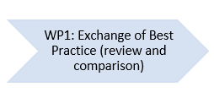
Results
Exchange of SM programmes
Comparison of existing SM programmes
Input of SM Experts

Slide 8
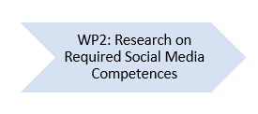
Results
Developed questionnaire about SM competencies
Used Google forms for data collection
Contacted over 100,000 companies
Received 527 responses
Forming the basis for four analysis reports

Slide 9
Results
Identifying competencies for the targeted model curriculum
criteria to form primary (core) and secondary (outer) competencies
Agreed on SM competencies, content, actors, delivery and change mechanisms
Form the basis of future testing activities and LTTAs

Slide 10
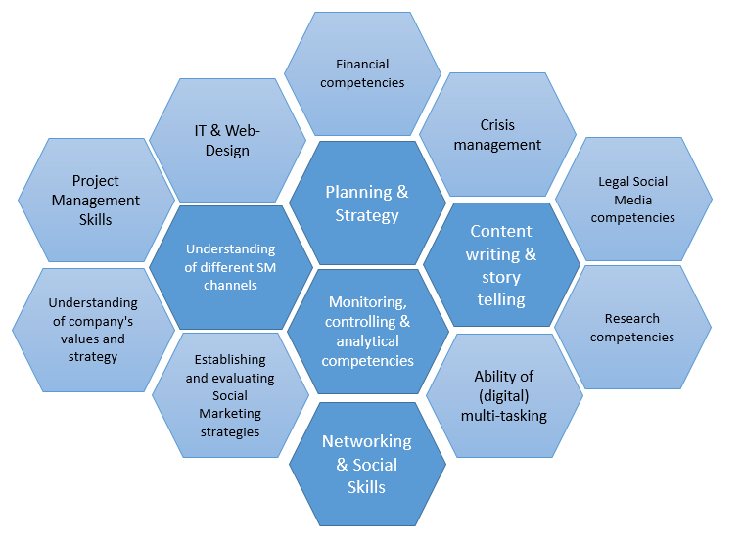
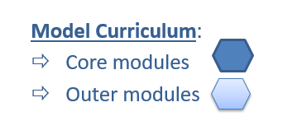
Results

Slide 11
How can my institution benefit?
Up-to date SM model curriculum based on the research of business needs
Free use of all project material
Flexible delivery as:
short course
part of a business programme | full- or part-time
series of one-day seminars
Offered to different target groups:
to individuals for personal development
to companies for staff development
to the student body

Slide 12
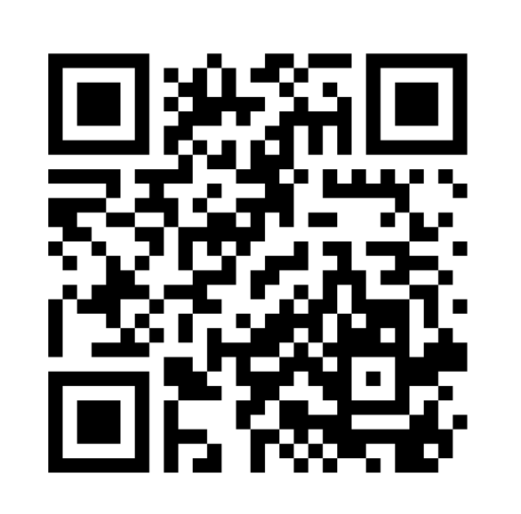
The EnDigiCom Project
Come and join us online:
EnDigiCom Padlet

Slide 13
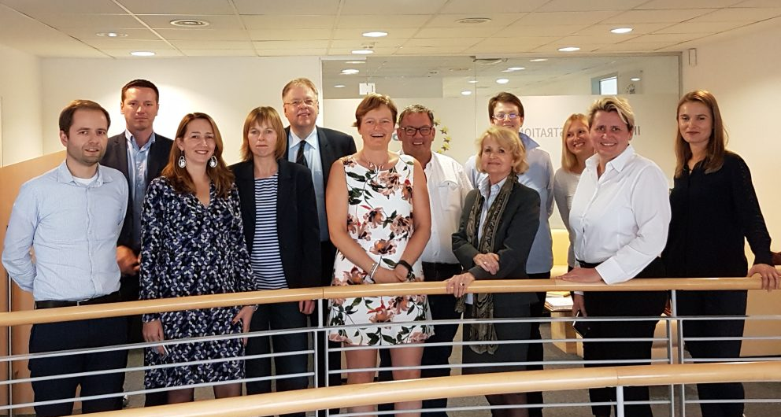
The EnDigiCom Project
https://www.ews-wien.at/endigicom/

Slide 14
Questions & Feedback
Questions?
Staying in contact:
https://www.ews-wien.at/endigicom/
https://padlet.com/birgit_binnyei/EnDigiCom_Workshop
https://www.slideshare.net/Endigicom/
birgit.binnyei@ews-wien.at

