Slide 1
THE DO‘S AND DON‘TS OF FULLY ONLINE DISTANCE LEARNING
The 32nd Annual Businet Conference 2018
Tallin Estonia

Slide 2
private higher education institution
nationally accredited but self-funded
18 years experience in providing supported fully online distance learning
international accreditations for online learning
1100 students
95 % fully online students
4 bachelor programmes
4 master programmes
1 PhD programme
206 teachers and tutors (not FTE)
Notes:
E-Learning Delivering Formats in EU Many formats from very basics to complex systems
Non traditinal but what is now days a non traditional student in the era of LLL
DOBA Business Online Learning Model
Teoretična izhodišča
socialni konstruktivizem
behaviorizem
kognitivizem
konektivizem
Supported fully online distance learning
Constructivist approach
Collaborative learning
Continuous assessment
Student-centeredness
Practice oriented approach based on competence development

Slide 3
THE REAL ‘GAME’ OF TEACHING DISTANCE & ONLINE
Don‘t
just do it
Do
define e-/online strategy clearly
form quality framework, institutional standards

Slide 4
STUDENT IS A KING
Don‘t
follow blindly the others
expect the right thinking and attitude is there
Do
know your students well
create study personas
prepare students for online learning

Slide 5
WE DON‘T EXPECT PILOTS TO FLY A MODERN JET WITHOUT ANY TRAINING, DO WE
Don‘t
take changed roles in teaching for granted
Do
support teachers

Slide 6
use standard platforms & environments
TECHNOLOGY IS (JUST) A TOOL
Don‘t
put technology before pedagogy
fall into the trap of overusing technology
Do
exploit technology potentials but make decisions pragmatically
Experiment … yet carefully

Slide 7
BACK TO BASICS …
Don‘t
copy F2F course
overload students
Do
redesign your teaching
simplify - less is more
evaluate & innovate

Slide 8
AND THE OSCAR GOES TO … ENGAGEMENT, INTERACTION & COLLABORATION
Don‘t
use ‘talking heads‘ approach
Do
facilitate learning as a social process
provide supporting networking –
value added of online learning

Slide 9
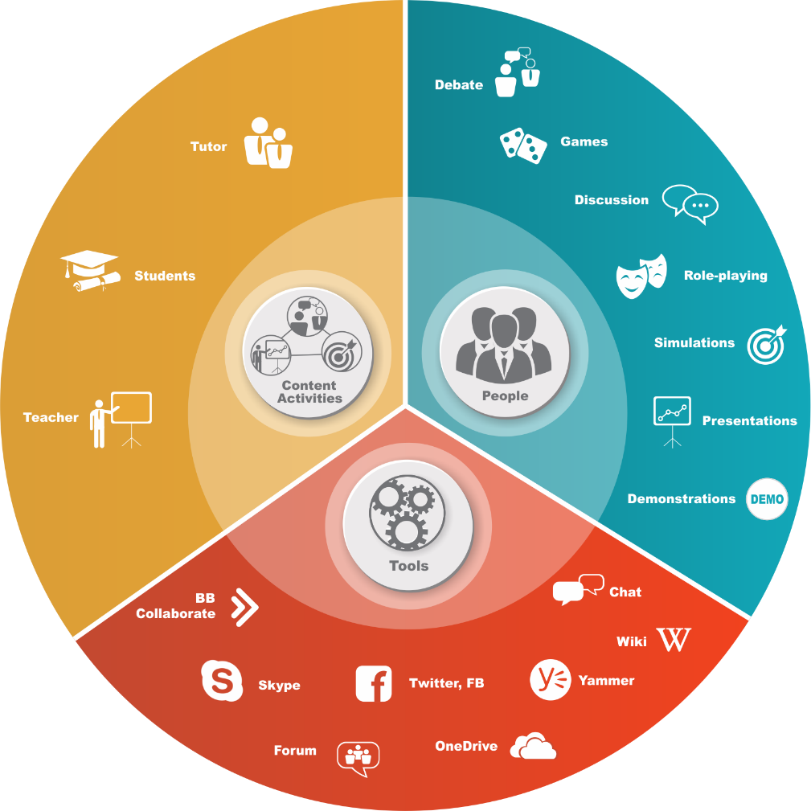
THE SECRET OF INSTRUCTIONAL DESIGN
Don‘t
misguide the learners
disrupt the flow
Do
structure learning activities and tasks
use clear guidelines and instructions
combine individual & group/team activities
use engaging, practice based and authentic activities and tasks, scenarios
make rich media content part of the course
integrate formative & summative assessment
provide feedback on continuous basis

Slide 10
NO SUPPORT NO SUCCESS
Don‘t
expect students can be self-managed and autonomous
Do
provide sustainable support structure
-pedagogical support
-administrative support
-technical support

Slide 11
Thank you
irena.amic@doba.si

