Slide 1
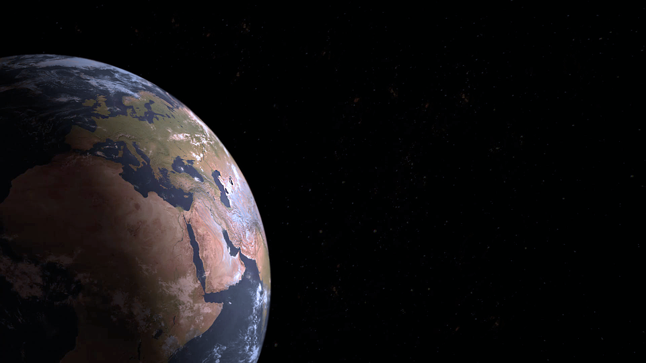
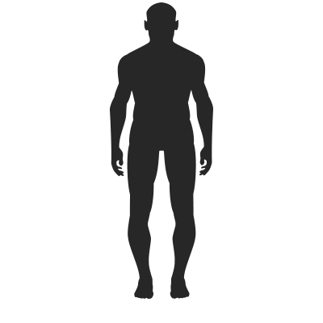
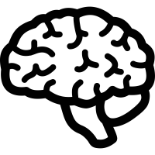
The greatest distance is not from New York to New Delhi. But from our head to our heart.
We have to bridge that distance.

Slide 2
Standard education verbal and mental teaching
The hidden power of creating awareness
lies in the communication from heart to heart
teacher touches the heart of the matter
touches the heart of the student

Slide 3
Chief Dan George
“ We are as much alive as we keep the Earth alive”

Slide 4
4 Elements in Education
AIR
FIRE
SOIL
WATER

Slide 5
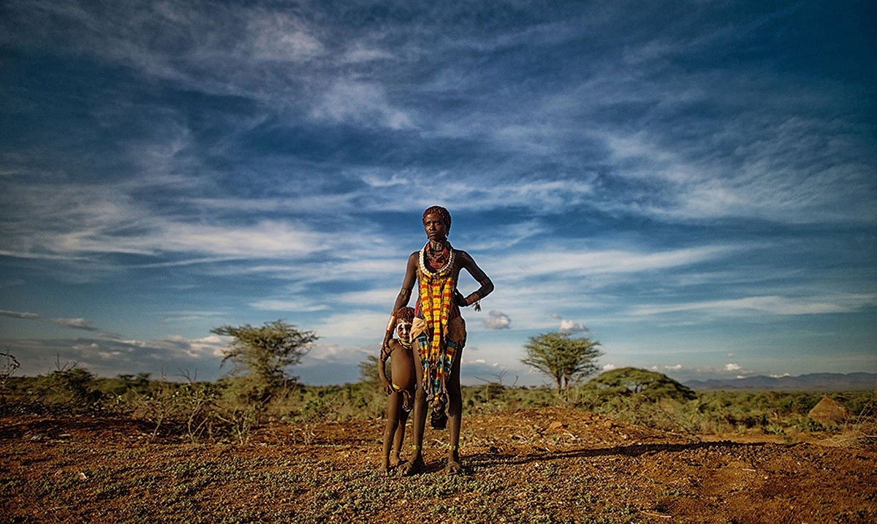
DOWN TO EARTH One family’s journey in search of the keepers of the earth

Slide 6
THE POWER OF SILENCE

Slide 7
Three brains
Cortex
1. Head Brain - Cortex
Logic / facts arguments
2. Heart Brain – Limbic brain
contains 2/3 more nerve cells than our head brain. It is intuitive non-verbal receiving subtle signals
3. Hara Brain – Brain Stem
contains 2/3 more nerve cells than our head brain. It is intuitive non-verbal, receiving subtle signals
Limbic Brain
Brain Stem
Amazing fact
95% of our communication is not based on words but it’s non verbal.

Slide 8
ALBERT EINSTEIN

Slide 9
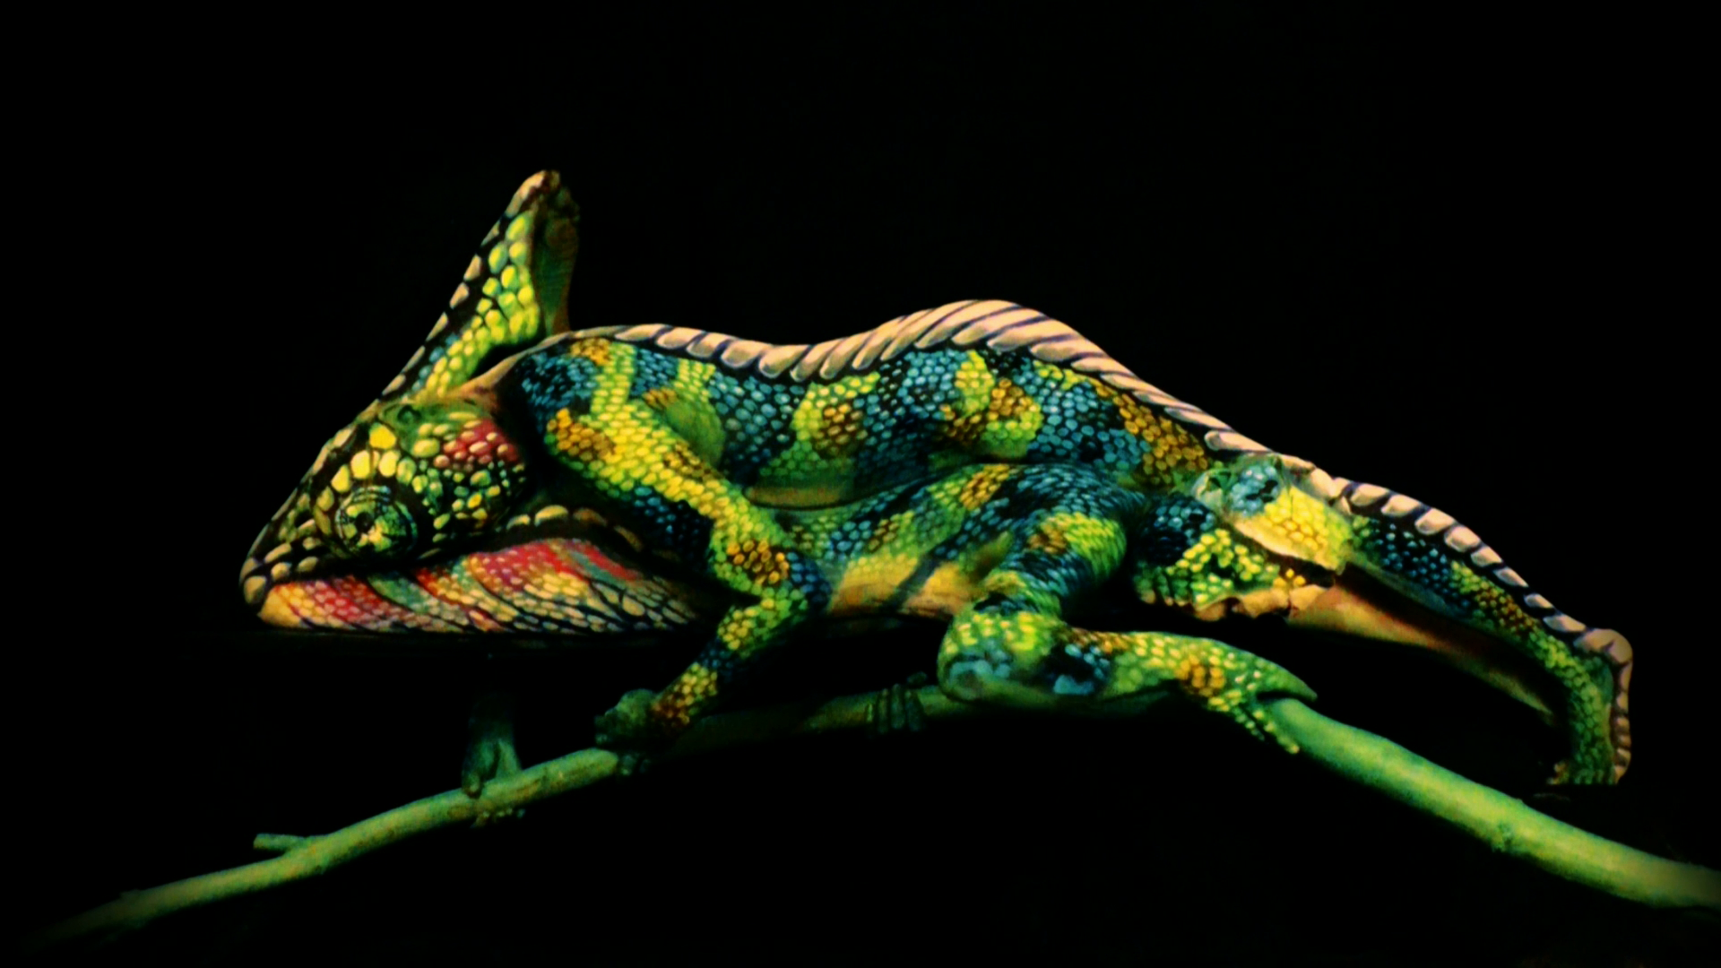
YOUR TRUE COLOURS
We have to find out what our true talents are
And to find out how can we use these true talent colours for
Earth-mind behaviour

Slide 10
Education for Personal Awareness
Each student makes a personal development plan,
the backbone should be the sustainability goals.
If students act from their hearts, from the SDG,
we provide
The people who see, feel, think and act differently

Slide 11
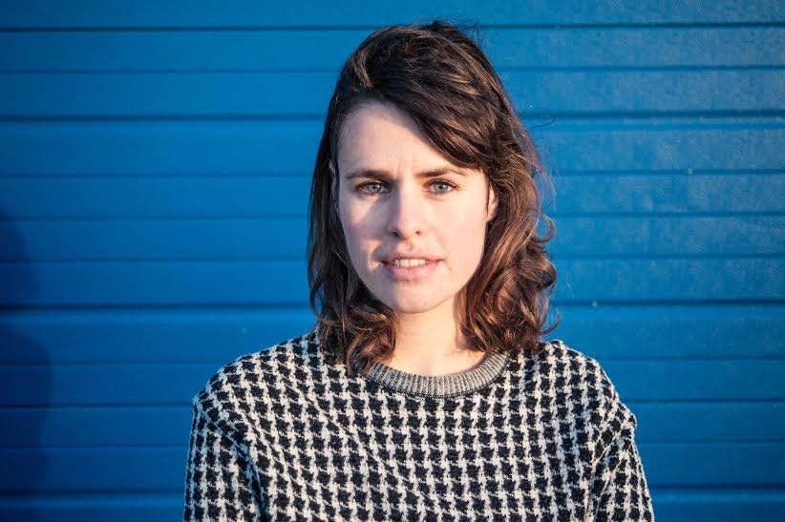
Joszi Smeets Former director youth food movement

Slide 12
Show your true Colours
Succesful education is based
Learning in a playful way
Heart related – talent related
with moments of Silence
attuned to the personal talents of students
Show your true colours game
related to the Earth Charter & SDG’s
https://vimeo.com/85103587

