Slide 1
Experiential Learning
BUSinet Student Conference: thinking Employment
Disaster Challenge 2018

Slide 2
Dale Lyon
Director
Concrete Scotland- ExpLearn
www.concreteinscotland.com

Slide 3
Activity
You will be transferred to the disaster zone tomorrow morning where an earthquake has struck the Falkirk area with the Epicentre being Carmuirs, Camelon. This area is quite open and very exposed to the elements. As a team we require you to organise your group with a: Project DirectorPublic Relations DirectorCivics DirectorPublic Order DirectorCost Controller

Slide 4
Tasks
We have established that after a disaster the search and rescue is imperative, however humanitarian aid is so important for the survivors to minimise the scale of on going mortality. We have seen the importance of shelter; water and sanitation. Your task is
1. Create a shelter which all your team can be protected from the environment
2. Create a means for water to be transported over 10 metres
3. Purify some water so it can be drunk
4. Cook a piece of food
5. Make a video appeal for support and aid for your work 6. Manage your Budget
6. Budget Control
7. create rules and Regulations to ensure a safe zone for your humanitarian aid

Slide 5
All teams created some form of shelter
There was no requirement to offer shelter to all of your team at the same time so materials could have been reduced and therefore lower your overall costs
Only 1 group requested scissors which would have assisted in cutting the polythene sheet and string

Slide 6
Great efforts in creating a system to transfer the water over 10metres. Two groups created a means for water transfer, whilst the other groups were happy to just form a line passing the buckets by hand

Slide 7
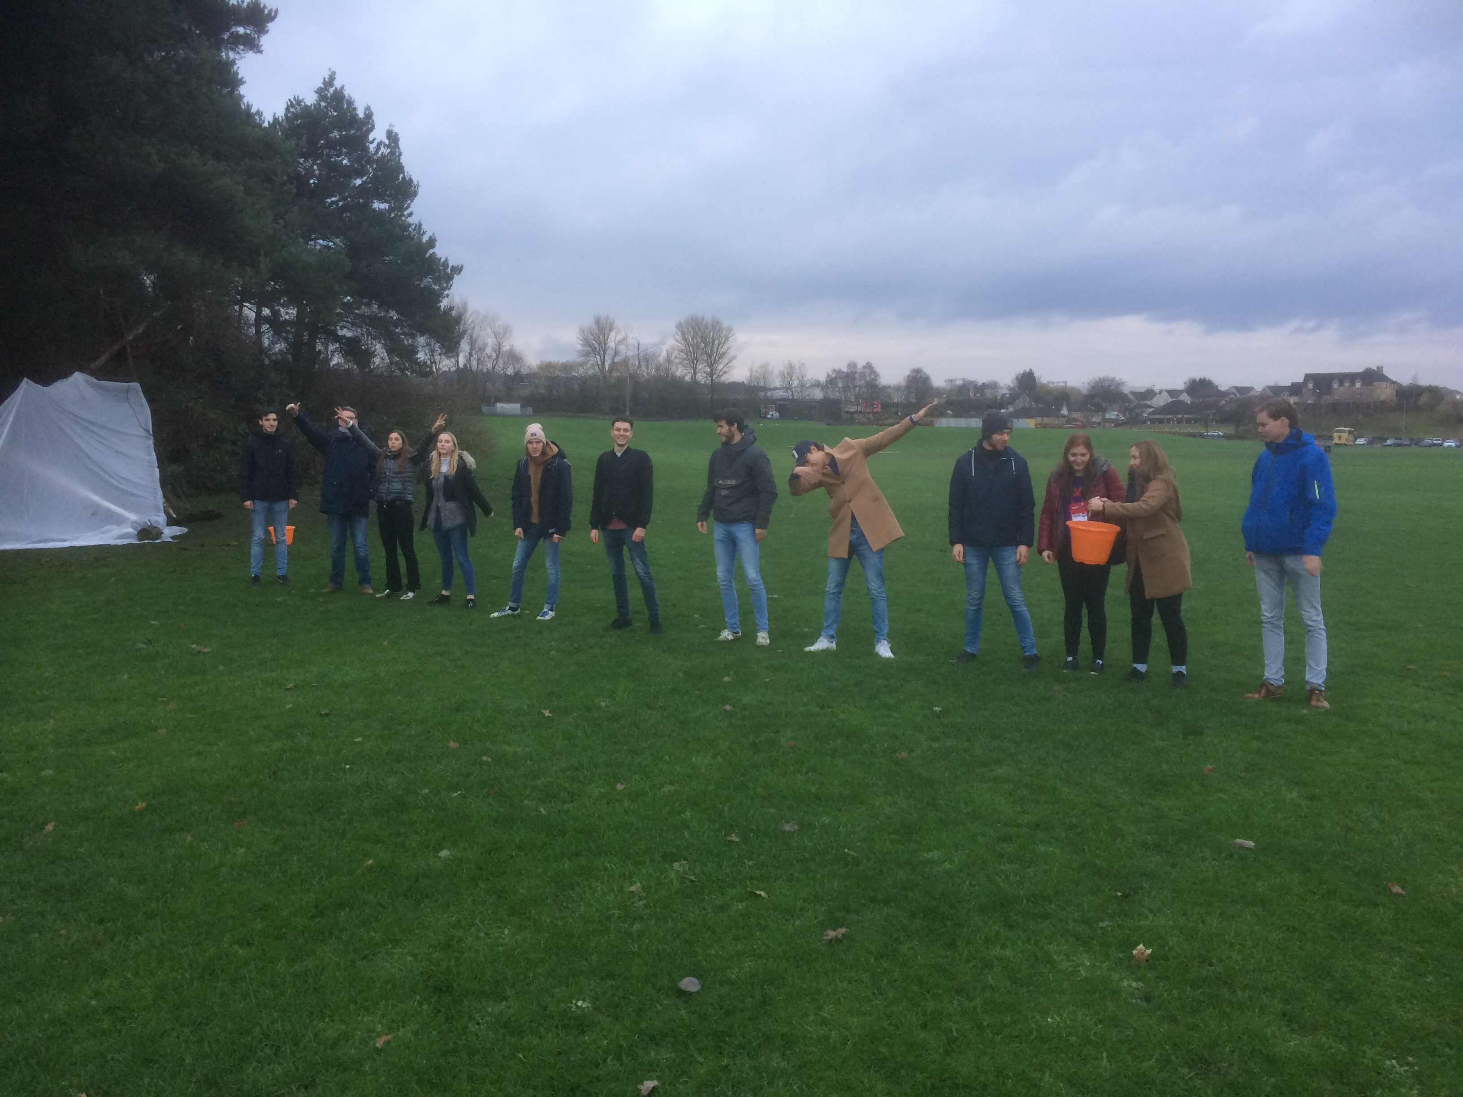

Slide 8
Boiling water to purify it, to make it safe to drink.
Students could have asked for purification tablets we had
Some groups created filtration, but not purifying the water as the task asked

Slide 10
All groups managed to create their fire and “cooked” their piece of meat

Slide 12
All teams created their Appeal videos, although a few were shorter than 2 minutes so didn’t maximise the income that could have been achieved

Slide 13
Only 1 team presented rules and regulations to ensure the safety within the disaster zone
No teams presented their budgets, although all teams had kept control of their costings

Slide 14
The Teams
Team Disaster
Chwazi
Very Sure
Life Net
International Rescue Rangers
World Savers
Team Muggles

Slide 15
Experiential Learning-
Learning through experience

Slide 16
Activity overview
Too often students spoke, in their teams in their first language, rather than in Business English, thus excluding some of their colleagues from the conversation
No preparation or research undertaken from the Monday introduction until the Tuesday activity, started, therefore there was no plan in place to tackle the activities
Too few questions asked, to ensure pre knowledge was maximised
Little leadership shown or organisation implemented
The activity required students to be supplying humanitarian aid to the location, not be those affected by the Earthquake (not a hurricane or bomb blast)

Slide 17
Transversal Skills 21st Century Skills Employabilitity
The skills individuals have which are relevant to jobs and occupations other than the ones they currently have or have recently had. These skills may also have been acquired through non-work or leisure activities or through participation in education or training.

Slide 18
Critical thinking, problem solving, reasoning
Interrogative Thinking, Research Skills
Creativity, artistry, curiosity, imagination, innovation, personal expression
Perseverance, self-direction, planning, self-discipline, adaptability, initiative
Scientific literacy, environmental and conservation literacy
Oral and written communication, public speaking and presenting, listening
Leadership, teamwork, collaboration, cooperation
Information and communication technology ( ICT ), literacy
Economic and financial literacy
Global awareness, humanitarianism
Health and wellness literacy, public health and safety

Slide 19
Leadership
The importance of leadership is not just about the way that you lead, it is the ability to motivate others to follow

Slide 20
Have A Plan
Plan – Plan and Plan again
Preparation is crucial to any task that you undertake
Fail to plan – plan to Fail

