Slide 1
Reflection, an essential and necessary element of professional behaviour
Stefan Schenke
Annual Businet Conference
November 9th, 2017

Slide 2
Reflection outcome ?
It was a very interesting task;
It was so funny and amusing;
I have learned a lot;
The collaboration with my fellow students was perfect;
I appreciate the support of my lecturer/coach
I have studied seriously
…
Figure 1a

Slide 3
Introduction workshop
Reflective practitioner (Schön)
Context: Dublin descriptors (2004)
Reflection
Qualities / Qualifications / Experiences
Perception / Memory
Learning to reflect Educational approach / consequences

Slide 4
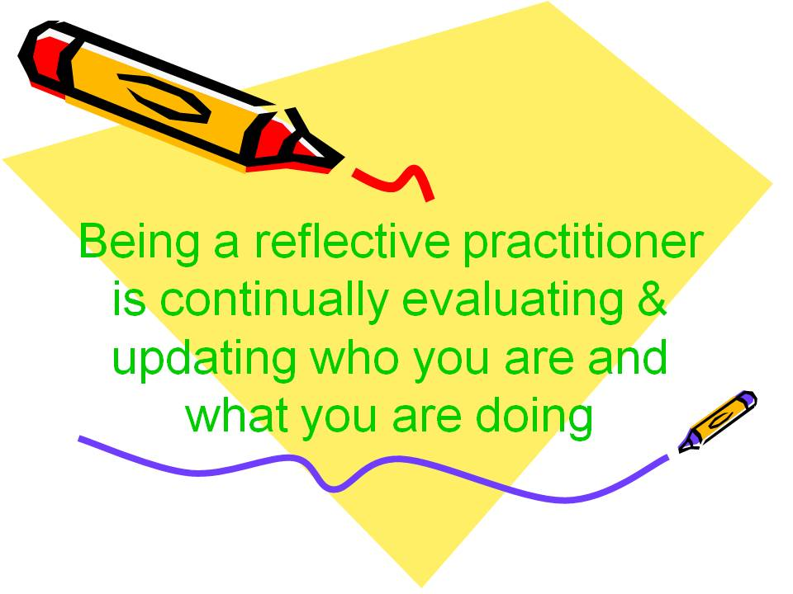
Reflective practitioner
Just 2 definitions (out of …):
A “reflective practitioner” is:
someone who does something (profession related content) and is automatically reflective.
someone who thinks about his/her experiences in practice and view them as opportunities to learn.
Figure 1b

Slide 5
Context
Dublin descriptors (2004):
Bachelor’s degree (first cycle)
have the ability to gather and interpret relevant data (usually within their field of study) to inform judgements that include reflection on relevant social, scientific or ethical issues
Master’s degree (second cycle)
have the ability to integrate knowledge and handle complexity, and formulate judgements with incomplete or limited information, but that include reflecting on social and ethical responsibilities linked to the application of their knowledge and judgements

Slide 6
Reflection
Figure 2a and 2b
What about reflection in education?

Slide 7
Reflection 2
Kant (1787) (Procee, 2006):
Distinction between “understanding” and “judgment”
Understanding has to be viewed in general as the faculty (the capability) of rules
Judgment is the faculty of subsuming under rules: that is, of distinguishing whether something does or does not stand under a given rule.

Slide 8
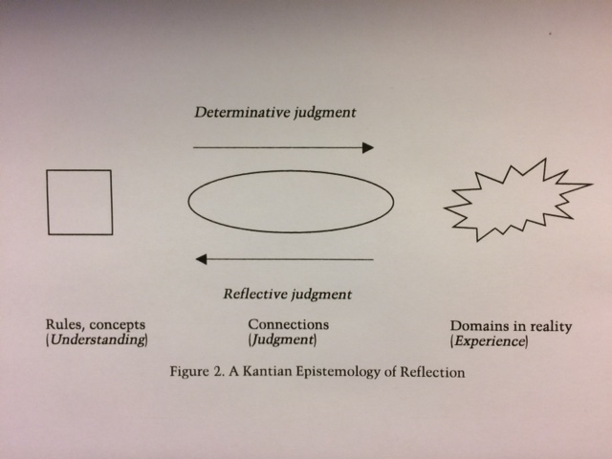
Reflection 3
Figure 3

Slide 9
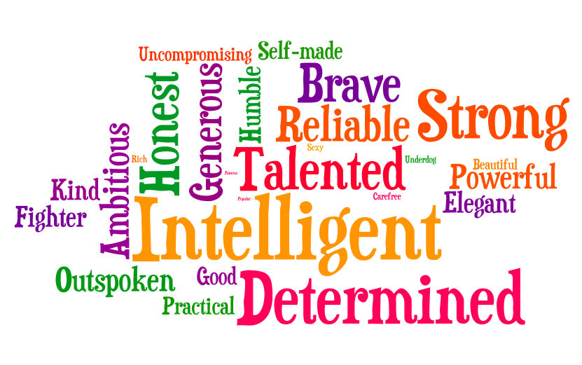
Requirements
Qualities: personal properties
and characteristics
Qualifications: formal professional competences
Experiences: the process or fact of personally observing, encountering, or undergoing something
Figure 4
Figure 5

Slide 10
Perception
Figure 6
Figure 7

Slide 11
Reality versus perception
Figure 8

Slide 12
Memory
Figure 9
Figure 10
No memory without experiences

Slide 13
Use of memory
Figure 11

Slide 14
Learning to reflect
A necessity for every student to become a professional (a reflective practitioner)
Learning by doing: (active process)
Figure 12

Slide 15
Individual point of reference
Creating tacit knowledge … part of unconscious capability
Figure 13

Slide 16
Educational approach / consequences
Create a context of practice.
Emphasize an individual experience-based outcome.
Let students review what happened and ask “why?”, “where?”, “what?” and “how?”.
Next to professional contents focus on a critical attitude.
Law of requisite variety (Ashby, 1956).
Essential principle of learning: repetition in-, on- and for action.
…

Slide 17
So: ….
Figure 14

Slide 18
Resources
Resources:
Figure 1a:
http://wikiclipart.com/wp-content/uploads/2017/09/Student-thinking-student-reflection-cliparts-clip-art-library.jpg November 2017
Figure 1b:
https://ilearn.marist.edu/access/content/user/10062631@marist.edu/Portfolio%20Documents/Reflective%20Practitioner.jpg October 2017
Figure 2a and 2b:
https://isardasorensen.files.wordpress.com/2014/02/tp-twilight-reflections-2-17-14.jpg September 2017
Figure 3:
Henk Procee, “Reflection in Education: a Kantian epistemology”, Educatonal Theory, 56, no. 3 (2006): 237 - 253
Figure 4:
https://belgiumstjohn.files.wordpress.com/2013/03/traits.png October 2017
Figure 5:
http://www.bohs.org/wp-content/uploads/2015/12/Qualifications-word-cloud2.jpg October 2017
Figure 6:
http://image.slidesharecdn.com/perception-111030224505-phpapp01/95/perception-1-728.jpg?cb=1320034002 September 2017
Figure 7:
https://i.ytimg.com/vi/b-Rne7WePxc/maxresdefault.jpg September 2017
Figure 8:
https://thewisdomoflife.files.wordpress.com/2014/05/0025-perceptionisreality.jpg September 2017
Figure 9:
http://suttons.s3.amazonaws.com/p/FRAPP24650_3.jpg September 2017

Slide 19
Figure 10:
http://rumroadravings.com/wp-content/uploads/2012/07/glass-of-beer.jpg September 2017
Figure 11:
http://www.hf.faa.gov/Webtraining/Cognition/cognition_images/3_stage_new.gif September 2017
Figure 12:
https://davidlintonpagedotcom.files.wordpress.com/2015/10/reflection-in-on-for-action.png?w=463&h=382 October 2017
Figure 13:
https://media.licdn.com/mpr/mpr/AAEAAQAAAAAAAAPTAAAAJDRjM2NhZjA5LTgzMTktNDY0My1hMmU4LTYzMjhlYzhlNmMxMQ.png October 2017
Figure 14:
https://lingeringvisions.files.wordpress.com/2016/11/the-sea-antoine-de-saint-exupery.jpg?w=637&h=469 October 2017

